Slide 1

The Block Chain
Authors:
Sean Achtatou
Sergei Tichomirov
The Block Chain
All Right Reserved ®
University Of Luxembourg

Slide 2

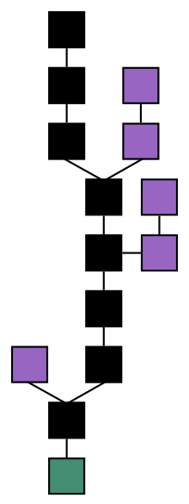

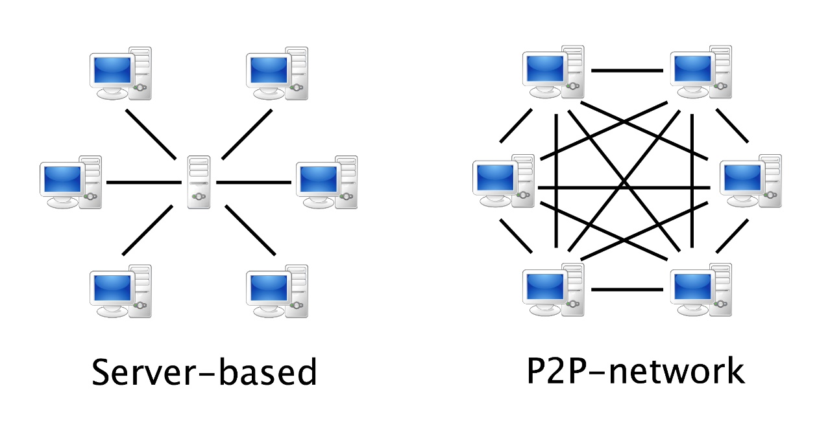




What is the Block Chain ?
- It is a Chain of connected Blocks
- It is a share Data in Peer to Peer
- It is an Highly Secured System
- It is used in many societies
- Future of the Security ?

Slide 3
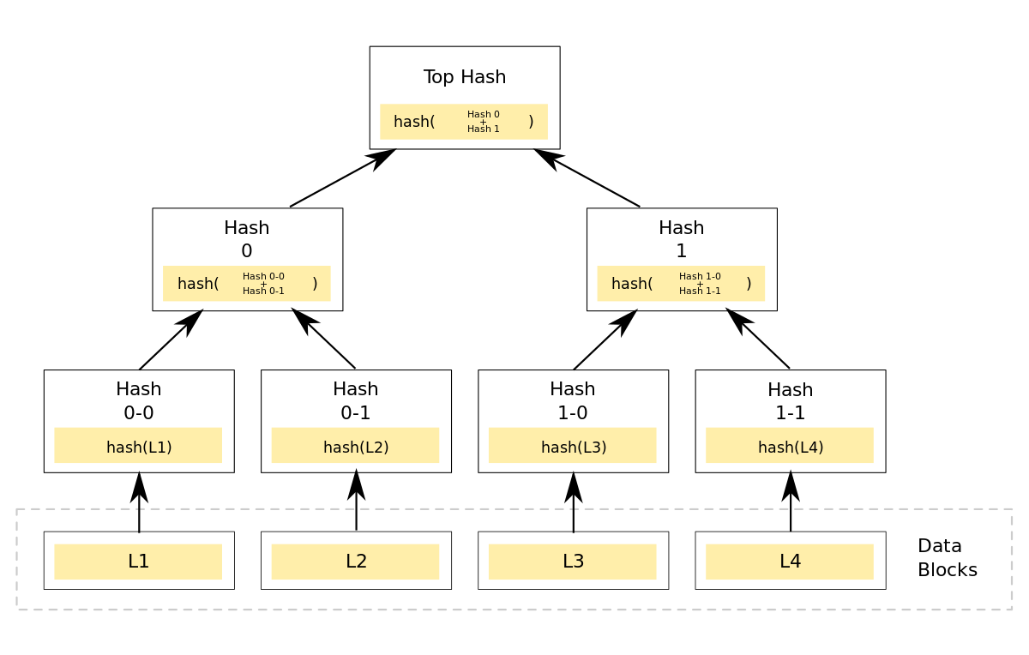
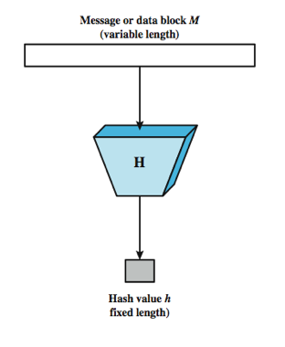
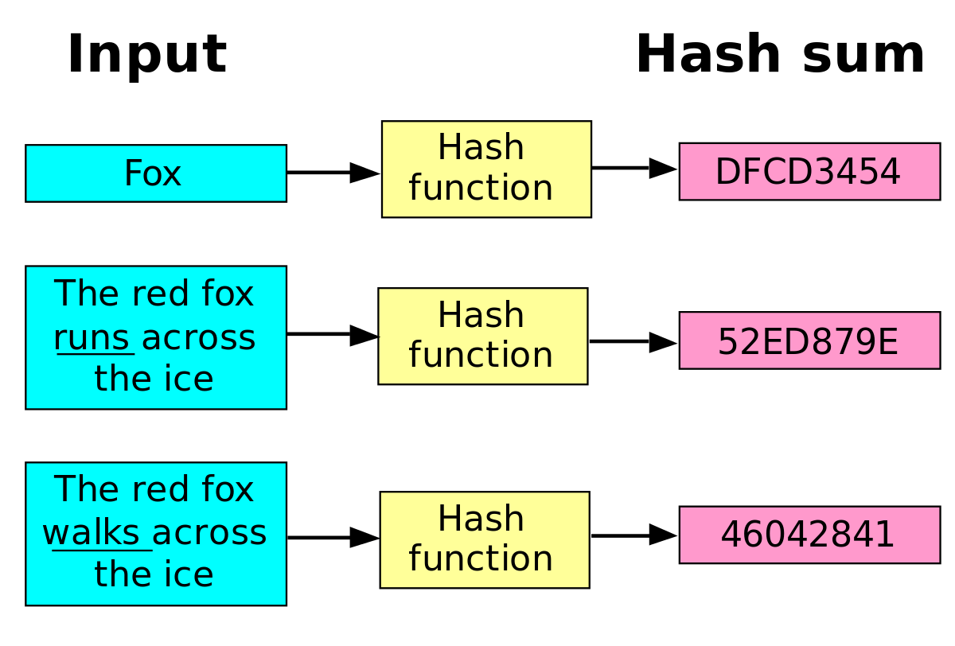
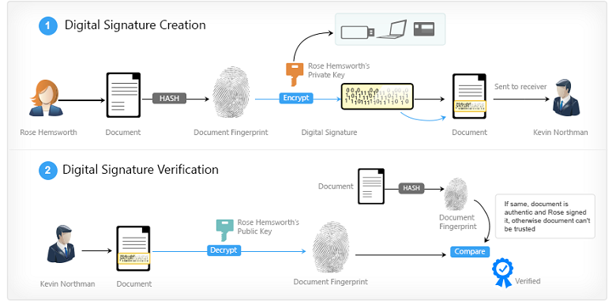

What compose the Block Chain [different parts] :
- An Hash function
- A Digital Signature
- A Merkle Tree

Slide 4

Hash Function, Digital Signature and local Block Chain in details

Slide 5
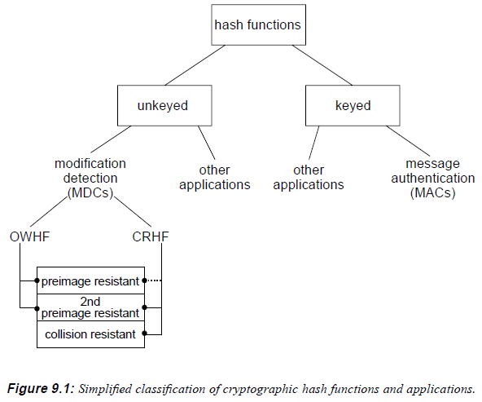
The Hash Function
1. Two Classes
1.1. Unkeyed
- Modification Detection Code (MDC)
1.2. Keyed
- Message Authentication Code (MAC)
2. Two types of Hash Function
2.1. Cryptographic (SHA)
- Deterministic
- One-way function (pre-image resistant)
- Collision resistant
- Second pre-image resistant
2.2. Non-Cryptographic (SeaHash)

Slide 6
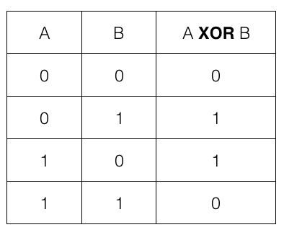
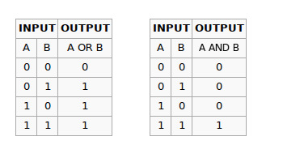
The Hash Function
3. Algorithm
3.1. XOR
3.2. Or/And
3.3. Complement
3.4. Bit shift left/right
3.5. Modulo
N Bit shift left << : U*2^N Exemple N = 3 : 101011010 * 8 = 011010000
N Bit shift right >> : U/2^N Exemple N =3 : 101011010 / 8 = 000101011
A = 4
B = 5
Modulo 6 : A+B mod 6 = (4+5)mod 6 = 9 mod 6 = 3

Slide 7
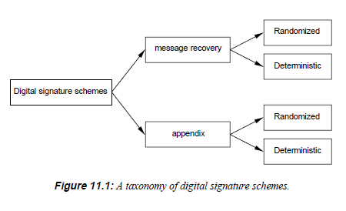
The Digital Signature
1. Properties
1.1. Authentication
1.2. Non-repudiation
1.3. Integrity
2. Three different algorithms
2.1. Key generation
- Public Key
- Private Key
2.2. Signing
2.3. Signature Verification
3. Two types of signature schemes
3.1. Appendix (DSA)
3.2. Message recovery (RSA)

Slide 8
The Digital Signature
4. Types of attacks on the DSA
-Total Break
- Selective Forgery
- Existential Forgery

Slide 9
The local Block Chain
1. Hash Function and Merkle Tree
2. JSON file ( Unconfirmed and Blocks )
Functions it must provide :
1. AddToUnconfirmed()
2. MineBlock()
2.1. Height
2.2. Hash ( prev_hash + Merkle Root + nonce < target )
2.3. Nonce
2.4. Prev_Hash
2.5. Merkle Tree
2.6. Transactions
3. Get_Block()
4. Find_tx()

Slide 10
Projects testing and results

Slide 11
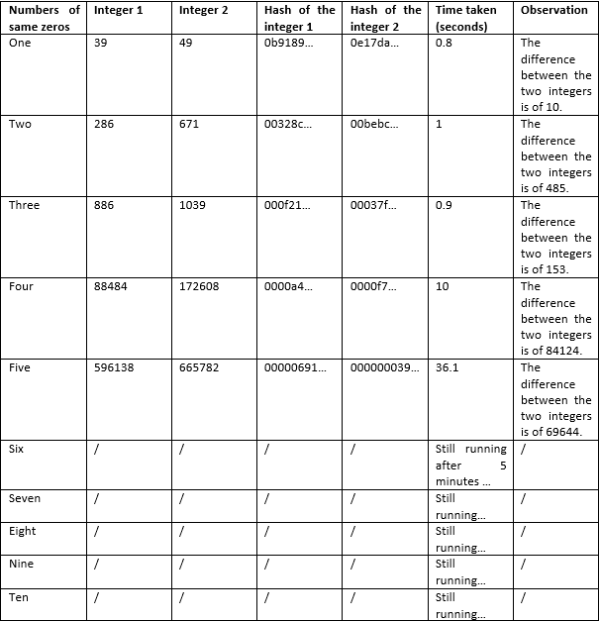
The Hash Function project

Slide 12
The Digital Signature project
Properties :
-Authentication
-Non-repudiation
-Integrity
Attacks :
-Total Break
- Selective Forgery
- Existential Forgery

Slide 13
def New_Transaction_Unconfirmed(a): #Append a new transaction unconfirmed to the Unconfirmed# BlockChain.unconfirmed["Unconfirmed"].append(a) print("[Success] Your transaction has been add to the unconfirmed transactions.")
The local Block Chain project
unconfirmed = {} unconfirmed["Unconfirmed"] = [] blocks = {} blocks["Blocks"] = []
1.Create two lists ( Unconfirmed and Blocks )
for i in range(nbB): # Create the blocks# block = {"Block" + " " + str(i): {"Height": i, "Hash": b, "Prev_Has": c, "Nonce": d, "MerkleRoot": e,"Txs":[]}} blocks["Blocks"].append(block)
2.JSON file ( Unconfirmed and Blocks )
def Mine_Block(): global nbB,Target for i in range(nbB): #Look in the unconfirmed if a transaction doesn't already exist in the blocks# for k in BlockChain.blocks["Blocks"][i]["Block" + " " + str(i)]["Txs"]: count = -1 for j in BlockChain.unconfirmed["Unconfirmed"]: count += 1 if k == j: print("[Warning] An unconfirmed transaction contains a transaction already found in a block, this transaction is being deleted from the unconfirmed.") del BlockChain.unconfirmed["Unconfirmed"][count] else: continue if BlockChain.unconfirmed["Unconfirmed"] == []: print("[Error] No transactions in the Unconfirmed, no block has been created.") else: block = {"Block" + " " + str(nbB): {"Height": nbB, "Hash": b, "Prev_Has": c, "Nonce": d, "MerkleRoot": e, "Txs": []}} BlockChain.blocks["Blocks"].append(block) for i in BlockChain.unconfirmed["Unconfirmed"]: BlockChain.blocks["Blocks"][nbB]["Block" + " " + str(nbB)]["Txs"].append(i) BlockChain.unconfirmed["Unconfirmed"] = [] # Read previous block hash# BlockChain.blocks["Blocks"][nbB]["Block" + " " + str(nbB)]["Prev_Has"] = BlockChain.blocks["Blocks"][nbB-1]["Block" + " " + str(nbB-1)]["Hash"] # Calculate MerkleRoot of transaction# BlockChain.blocks["Blocks"][nbB]["Block" + " " + str(nbB)]["MerkleRoot"] = Merkle_Tree_Function.Merkle_Tree(BlockChain.blocks["Blocks"][nbB]["Block" + " " + str(nbB)]["Txs"]) # Find nounce# Cst = str(BlockChain.blocks["Blocks"][nbB]["Block" + " " + str(nbB)]["MerkleRoot"]) + str(BlockChain.blocks["Blocks"][nbB]["Block" + " " + str(nbB)]["Prev_Has"]) + str(BlockChain.blocks["Blocks"][nbB]["Block" + " " + str(nbB)]["Nonce"]) Tcs = hashlib.sha256(Cst.encode()).hexdigest() Bts = abs(hash(Tcs)) while Bts > Target: BlockChain.blocks["Blocks"][nbB]["Block" + " " + str(nbB)]["Nonce"] += 1 Cst = str(BlockChain.blocks["Blocks"][nbB]["Block" + " " + str(nbB)]["MerkleRoot"]) + str(BlockChain.blocks["Blocks"][nbB]["Block" + " " + str(nbB)]["Prev_Has"]) + str(BlockChain.blocks["Blocks"][nbB]["Block" + " " + str(nbB)]["Nonce"]) Tcs = hashlib.sha256(Cst.encode()).hexdigest() Bts = abs(hash(Tcs)) BlockChain.blocks["Blocks"][nbB]["Block" + " " + str(nbB)]["Hash"] = Tcs nbB +=1
def Search_Block_Contents(a): print("Informations for the Block",a,":") try: print(BlockChain.blocks["Blocks"][int(a)]["Block"+" "+a]) print("[Success] The contents for the Block", an, "has been displayed.") except: print("[Error] The Block Height you entered doesn't exist.") #Read for each block the height, once found, print the block contents# return
3. Five blocks already in the Block Chain
with open("data.txt", "w") as i: # Put all the data in a data.txt file# json.dump(BlockChain.unconfirmed, i, indent=4) json.dump(BlockChain.blocks, i, indent=4) i.close()
4. Implementation :
1. AddToUnconfirmed()
2. MineBlock()
blocks["Blocks"][0]["Block 0"]["Txs"].append(hashlib.sha256("Test".encode()).hexdigest()) blocks["Blocks"][0]["Block 0"]["Txs"].append(hashlib.sha256("Hello".encode()).hexdigest()) blocks["Blocks"][0]["Block 0"]["Txs"].append(hashlib.sha256("World".encode()).hexdigest()) blocks["Blocks"][1]["Block 1"]["Txs"].append(hashlib.sha256("Bye".encode()).hexdigest()) blocks["Blocks"][1]["Block 1"]["Txs"].append(hashlib.sha256("Have fun".encode()).hexdigest()) blocks["Blocks"][1]["Block 1"]["Txs"].append(hashlib.sha256("See you".encode()).hexdigest()) blocks["Blocks"][2]["Block 2"]["Txs"].append(hashlib.sha256("This".encode()).hexdigest()) blocks["Blocks"][2]["Block 2"]["Txs"].append(hashlib.sha256("is".encode()).hexdigest()) blocks["Blocks"][2]["Block 2"]["Txs"].append(hashlib.sha256("sparta".encode()).hexdigest()) blocks["Blocks"][3]["Block 3"]["Txs"].append(hashlib.sha256("I".encode()).hexdigest()) blocks["Blocks"][3]["Block 3"]["Txs"].append(hashlib.sha256("am".encode()).hexdigest()) blocks["Blocks"][3]["Block 3"]["Txs"].append(hashlib.sha256("groot".encode()).hexdigest()) blocks["Blocks"][4]["Block 4"]["Txs"].append(hashlib.sha256("Hello".encode()).hexdigest()) blocks["Blocks"][4]["Block 4"]["Txs"].append(hashlib.sha256("is it me".encode()).hexdigest()) blocks["Blocks"][4]["Block 4"]["Txs"].append(hashlib.sha256("you looking for".encode()).hexdigest()) blocks["Blocks"][5]["Block 5"]["Txs"].append(hashlib.sha256("It".encode()).hexdigest()) blocks["Blocks"][5]["Block 5"]["Txs"].append(hashlib.sha256("doesn't work".encode()).hexdigest()) blocks["Blocks"][5]["Block 5"]["Txs"].append(hashlib.sha256("that way".encode()).hexdigest())
2.1. Height
2.2. Hash ( prev_hash + Merkle Root + nonce < target )
def Search_Transaction_Hash_Block(a): for i in range(nbB): for k in BlockChain.blocks["Blocks"][i]["Block" + " " + str(i)]["Txs"]: if k == hashlib.sha256(a.encode()).hexdigest(): print("[Success] Transaction found in the Block",i) print("Hash of the Block",i,":",BlockChain.blocks["Blocks"][i]["Block"+" "+str(i)]["Hash"]) return else: continue print("[Error] The transaction hasn't been found in any Blocks.") return None
2.3. Nonce
2.4. Prev_Hash
2.5. Merkle Tree
2.6. Transactions
3. Get_Block()
4. Find_tx()

Slide 14

Conclusion

